Slide 1


DATA221 Intro Machine Learning 06 misc fitting issues
William Trimble
Spring 2022

Slide 2
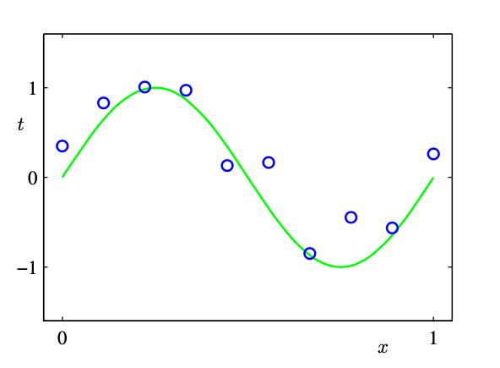
Linear (polynomial coefficient) regression example
Artificial “training” dataset :
y = sin(2 𝜋 x) + 0.1 * N (mean=0, std=1)
Example from Bishop, Pattern Recognition and Machine Learning (2006)

Slide 3
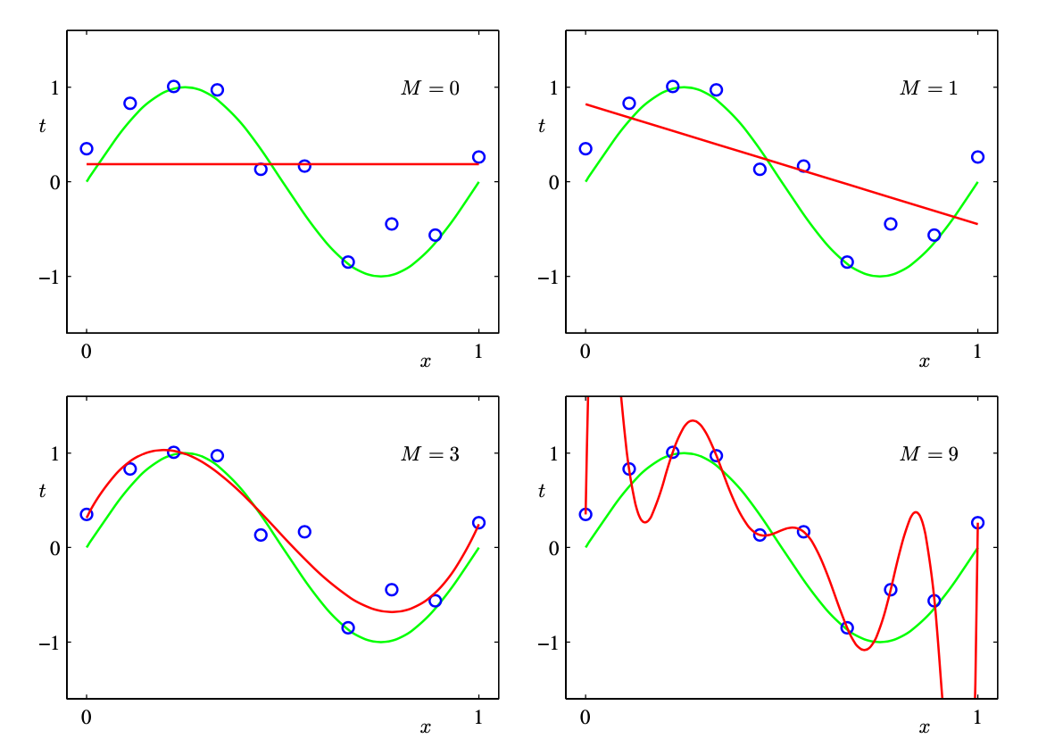
OLS fits to polynomial coefficients minimizing mean squared error.
constant,
linear,
cubic and
x⁹ - polynomials

Slide 4
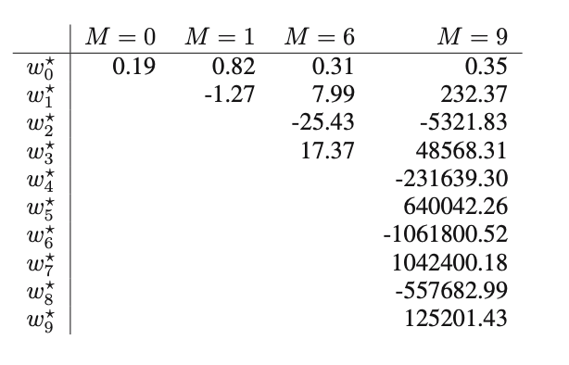
If you look at the coefficients, they don’t inspire confidence:
More complex models have fit coefficients that start to look ugly:

Slide 5
Why does it do this?
A = Sum_{i} e_{i}^{T} λ_{i} e_{i}
n
A
e₁^{T}
Q⁻¹
Σ
Q
λ₁
e₂
e₃
e₄
=
e₂^{T}
λ₂
n
det A = Π λ_{i}
e₃^{T}
λ₃
e₄^{T}
λ₄
n
A⁻¹
e₁^{T}
Q⁻¹
Σ
Q
λ₁⁻¹
e₂
e₃
e₄
=
e₂^{T}
λ₂⁻¹
n
e₃^{T}
λ₃¹⁻
det A⁻¹ = Π λ_{i}⁻¹
e₄^{T}
λ₄⁻¹

Slide 6
Why does it do this?
A = Sum_{i} e_{i}^{T} λ_{i} e_{i}
n
A
e₁^{T}
Q⁻¹
Σ
Q
λ₁
e₂
e₃
e₄
When pairs of rows/ columns in A are close but not the same,
eigenvalues of A get small. Jargon: “Ill-conditioned design matrix”
=
e₂^{T}
λ₂
n
det A = Π λ_{i}
e₃^{T}
λ₃
e₄^{T}
λ₄
n
A⁻¹
e₁^{T}
Q⁻¹
Σ
Q
λ₁⁻¹
e₂
e₃
e₄
=
e₂^{T}
λ₂⁻¹
n
e₃^{T}
λ₃¹⁻
det A⁻¹ = Π λ_{i}⁻¹
e₄^{T}
λ₄⁻¹

Slide 7
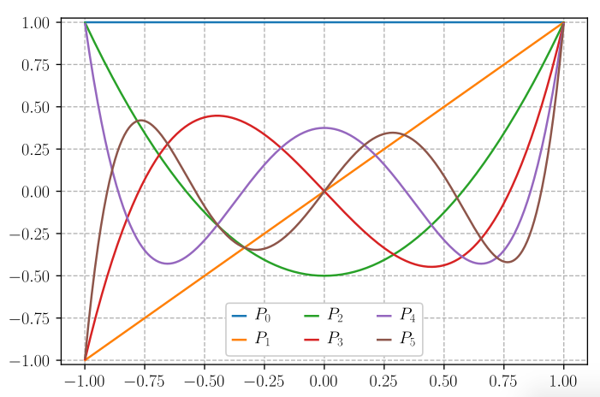
One approach is
choosing basis
vectors that are
orthogonal:
”in different directions”
won’t interfere with
each other.

Slide 8
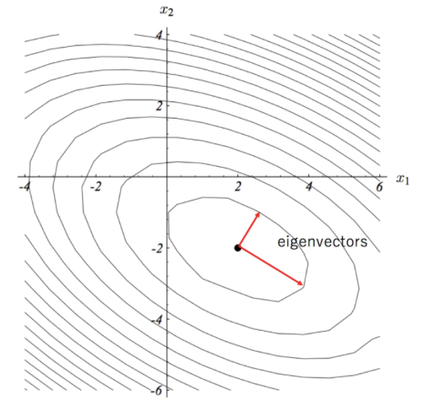
So what? some eigenvalues are small.
This doesn’t do anything bad, does it?
b = (X^{T} X)⁻¹X^{T} Y
The inverse of X^{T} X has eigenvalues that
are the inverses of the eigenvalues in X^{T} X.
So small eigenvalues in X^{T} X mean large
eigenvalues (and large volume transformations)
in (X^{T} X)⁻¹
But.. I’m applying (X^{T} X)⁻¹ to something
proportional to Y, which has ”noise” on it.

Slide 9
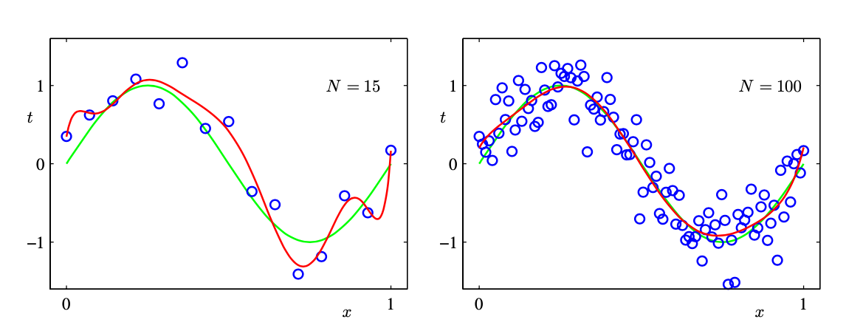
Don’t overfit: more data
One remedy is to include more data.
More terms in the likelihood (probably) will
guide us closer to a solution that is more generalizable
More terms in the likelihood makes the peak sharper

Slide 10
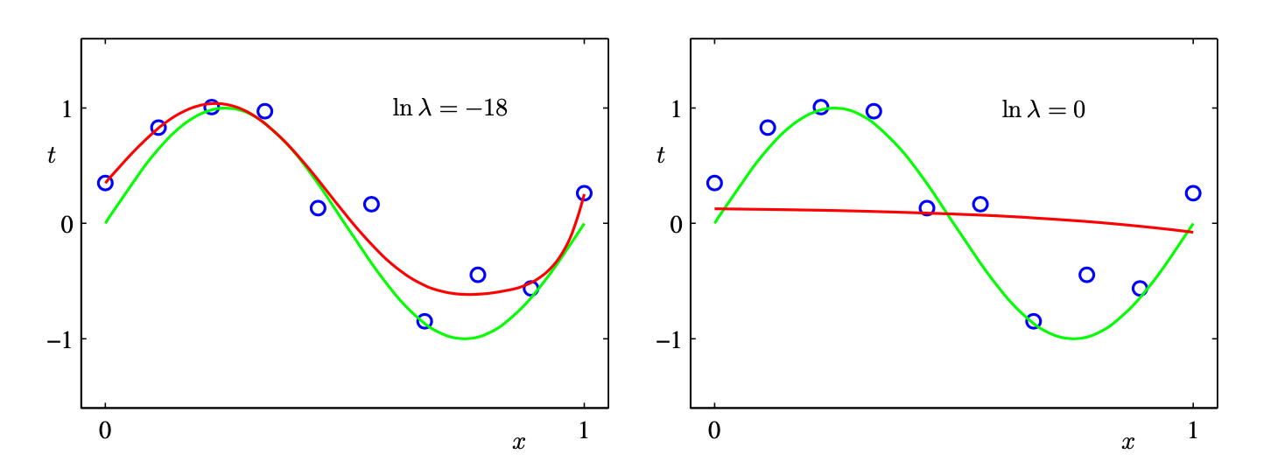
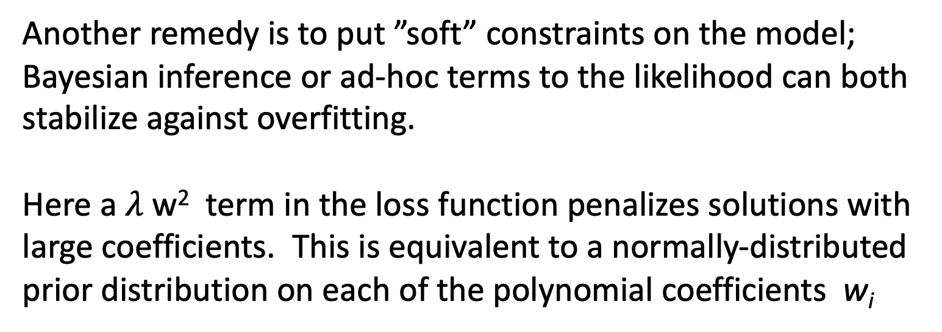
Don’t overfit: regularize
Another remedy is to put ”soft” constraints on the model; Bayesian inference or ad-hoc terms to the likelihood can both stabilize against overfitting.
Here a $λ$ w² term in the loss function penalizes solutions with large coefficients. This is equivalent to a normally-distributed prior distribution on each of the polynomial coefficients w_{i}

Slide 11
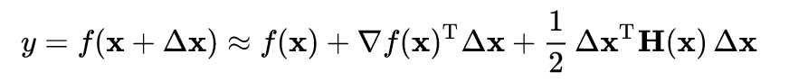
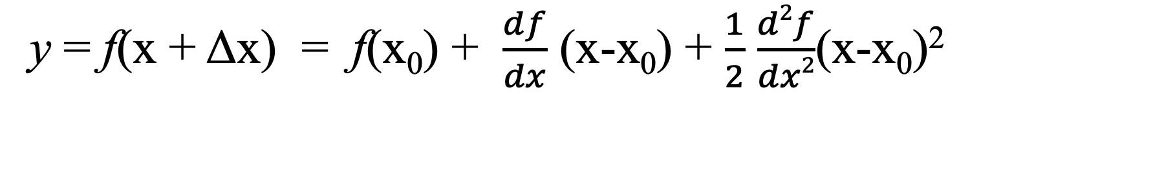
First and second derivatives in multiple dimensions
y = f(x + Δx) = f(x₀) + $\frac{df}{dx}$ (x-x₀) + $\frac{1}{2}$ $\frac{d2f}{dx2}$(x-x₀)²
What is f?
n x 1
n x n
symmetric
Which way is downhill?
Which way is the
maximum, minimum
curvature?

Slide 12

Gradient descent.. the simplest way to optimize
To find argmin_x f(x)
Start somewhere. x₀
Measure or estimate ∇f(x₀)
Set x₁ = x₀ - constant * ∇f(x₀)

Slide 13
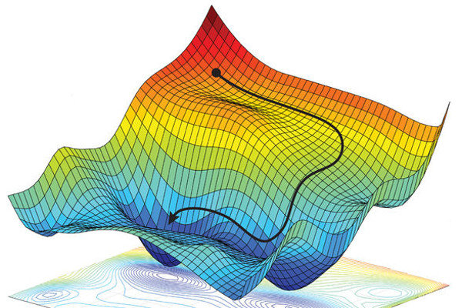

Slide 14
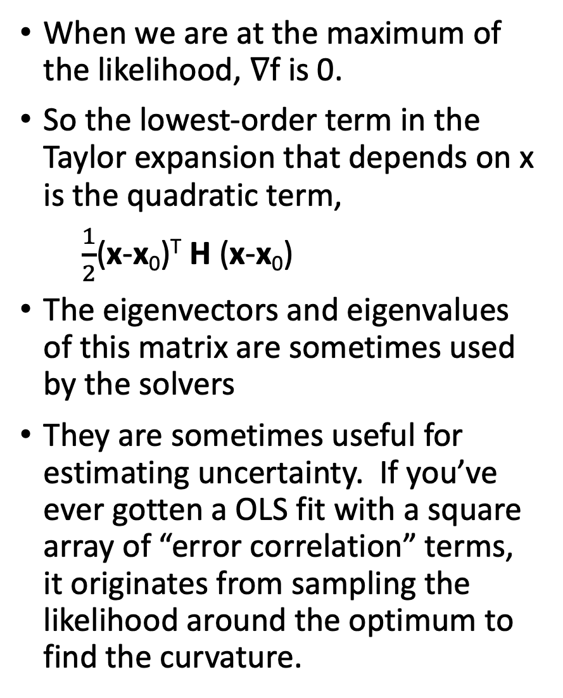
When we are at the maximum of the likelihood, ∇f is 0.
So the lowest-order term in the Taylor expansion that depends on x is the quadratic term,
$\frac{1}{2}$(x-x₀)^{T} H (x-x₀)
The eigenvectors and eigenvalues of this matrix are sometimes used by the solvers
They are sometimes useful for estimating uncertainty. If you’ve ever gotten a OLS fit with a square array of “error correlation” terms, it originates from sampling the likelihood around the optimum to find the curvature.

Slide 15
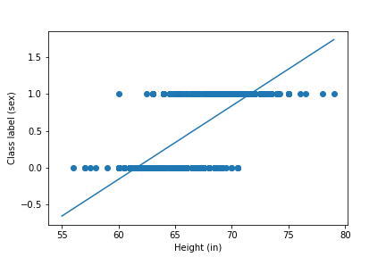
Linear regression on Galton height data

Slide 16
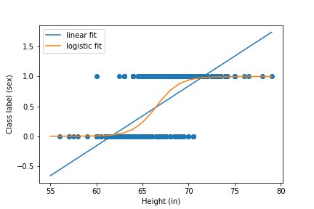
Logistic regression on Galton height data

